Slide 1


CVCS Escapement Modeling
The Mathematics of the CVCS Escapement Model
Presented by:
Arthur Barros, California Department of Fish and Wildlife
Arthur.Barros@wildlife.ca.gov

Slide 2
Session goals
Review the CVCS carcass survey data.
Explain equations to estimate capture and survival probabilities.
Review likelihood and Maximum Likelihood Estimation (MLE) methods.

Slide 3
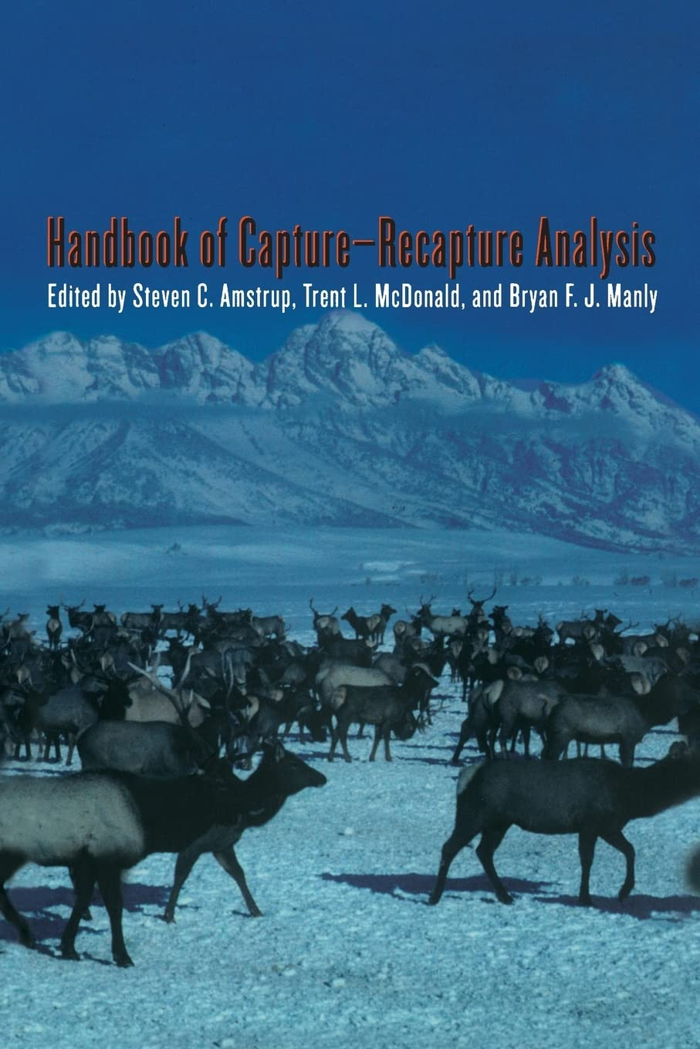
Resources I found useful
Steven C. Amstrup, Trent L. Mcdonald, and Bryan F.J. Manly. Handbook of Capture-Recapture Analysis. Princeton Univ. Press, 2005. url: http://www.jstor.org/stable/j.ctt7sdj6.
Estimating apparent survival, lecture from University of Georgia, https://rushinglab.github.io/WILD6900/articles/cjs.html
escapeMR github page: https://gitlab.com/tmcd/escapemr/-/tree/master/R?ref_type=heads

Slide 4
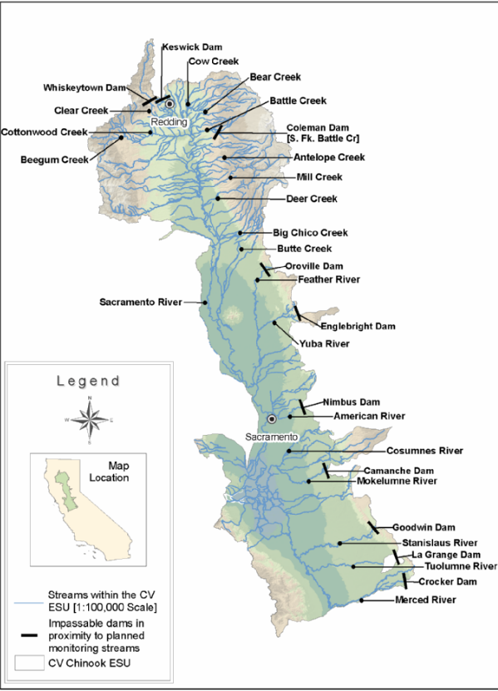
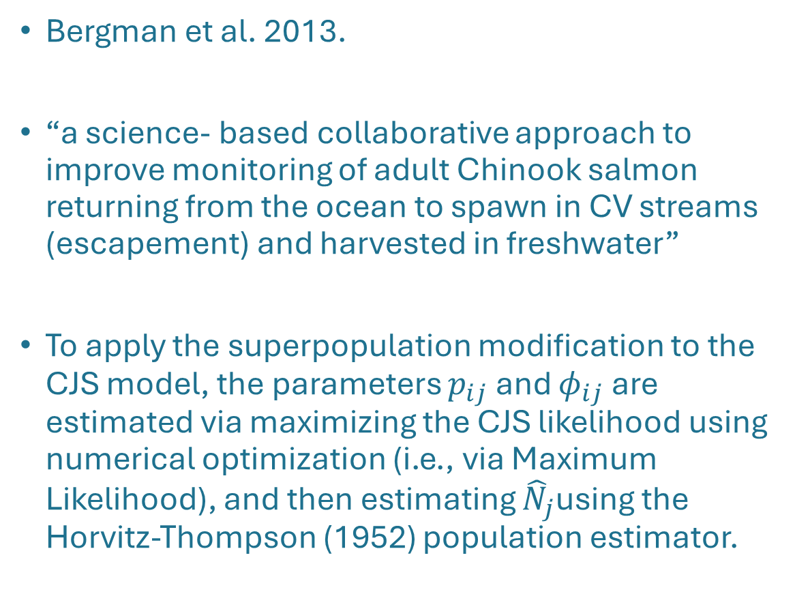
CVCS Escapement Monitoring Plan
Bergman et al. 2013.
“a science- based collaborative approach to improve monitoring of adult Chinook salmon returning from the ocean to spawn in CV streams (escapement) and harvested in freshwater”
To apply the superpopulation modification to the CJS model, the parameters $p_{ij}$ and ${\text{φ}}_{ij}$are estimated via maximizing the CJS likelihood using numerical optimization (i.e., via Maximum Likelihood), and then estimating ${\hat{N}}_{j}$using the Horvitz-Thompson (1952) population estimator.
Bergman, J. M., Nielson, R. M., & Low, A. (2013). CENTRAL VALLEY CHINOOK SALMON IN-RIVER ESCAPEMENT MONITORING PLAN. Paper Knowledge . Toward a Media History of Documents, 12–26.

Slide 5
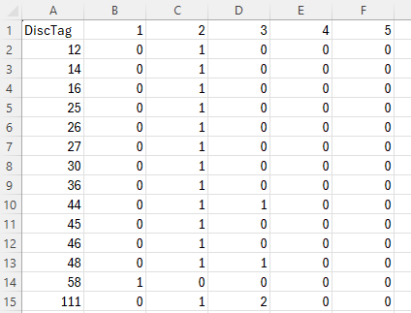
The Data: capture histories
Records of capture and recapture for a given carcass.
0 = indicates carcass was not capture during that period.
1 = indicates carcass was captured and returned.
2 = carcass was captured and “chopped”.
demo_CH.csv

Slide 6
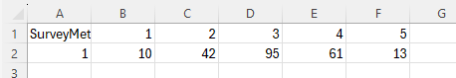
The Data: chops
Records of number of carcasses removed from system upon first capture.
Done when carcass is deteriorated beyond identification or measurement, and won’t last long enough for further recaptures.
demo_Chops.csv

Slide 7
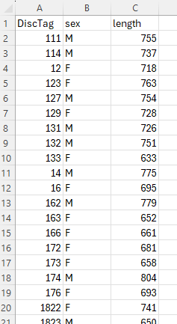
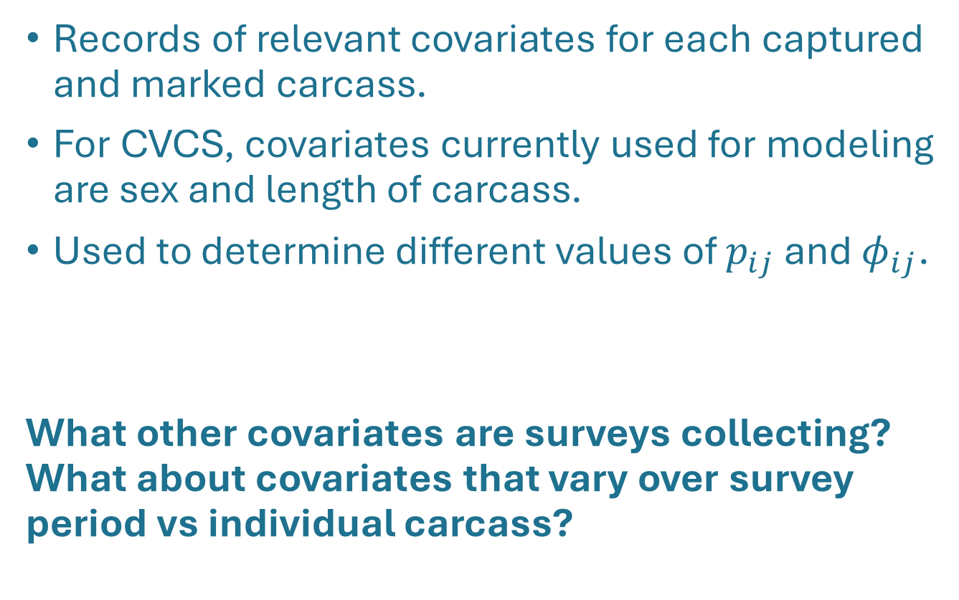
The Data: covariates
Records of relevant covariates for each captured and marked carcass.
For CVCS, covariates currently used for modeling are sex and length of carcass.
Used to determine different values of $p_{ij}$ and ${\text{φ}}_{ij}$.
What other covariates are surveys collecting? What about covariates that vary over survey period vs individual carcass?
demo_Covariates.csv

Slide 8
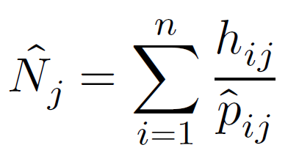
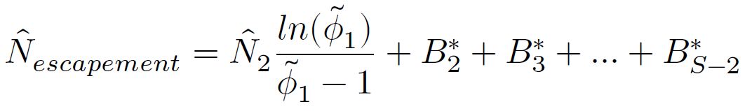
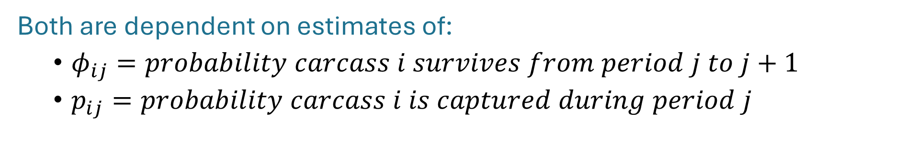
Estimating $p_{ij}$ and ${\text{φ}}_{ij}$
Recall the Horvitz-Thompson estimator:
and the superpopulation modification:
Both are dependent on estimates of:
${\text{φ}}_{ij}=probability carcass i survives from period j to j+1$
$p_{ij}=probability carcass i is captured during period j$

Slide 9
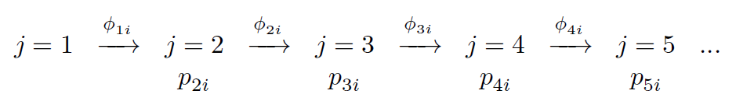
Estimating $p_{ij}$ and ${\text{φ}}_{ij}$
We can use $p_{ij}$ and ${\text{φ}}_{ij}$ to represent the capture history of a given carcass i during period j as:

Slide 10
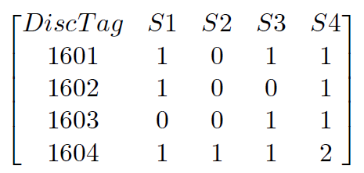
Estimating $p_{ij}$ and ${\text{φ}}_{ij}$
Consider this simplified set of capture histories:
We can represent the likelihood of observing the capture history of fish 1601 as:

Slide 11
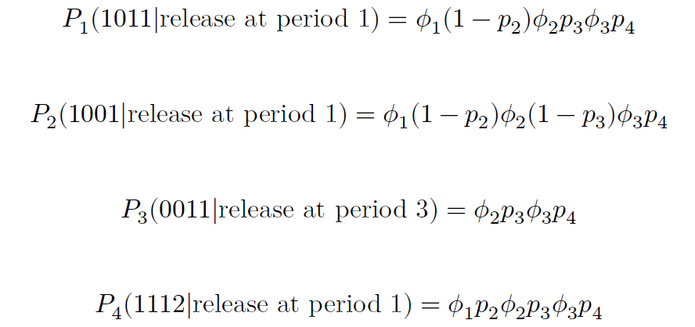
Estimating $p_{ij}$ and ${\text{φ}}_{ij}$
We can represent the likelihood of observing our four capture histories as:
Notes:
In the above note the 2 at the end of the last capture history representing a chopped event. Chopped carcasses will be dealt with later. Also note that for 𝑃3 the likelihood conditions on the initial observation and excludes estimates of 𝜙 or 𝑝 before that period.

Slide 12
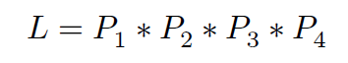
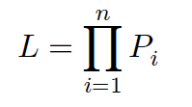
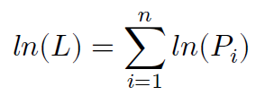
Estimating $p_{ij}$ and ${\text{φ}}_{ij}$
We can use the prior equations to represent the total likelihood of observing all capture histories as:
Or as the product of all the n capture history probabilities as:
Which can be made easier for computation by log-transforming our likelihoods:
The above is known as the “log-likelihood” of the probability.

Slide 13
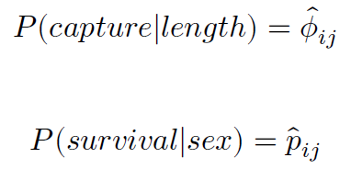
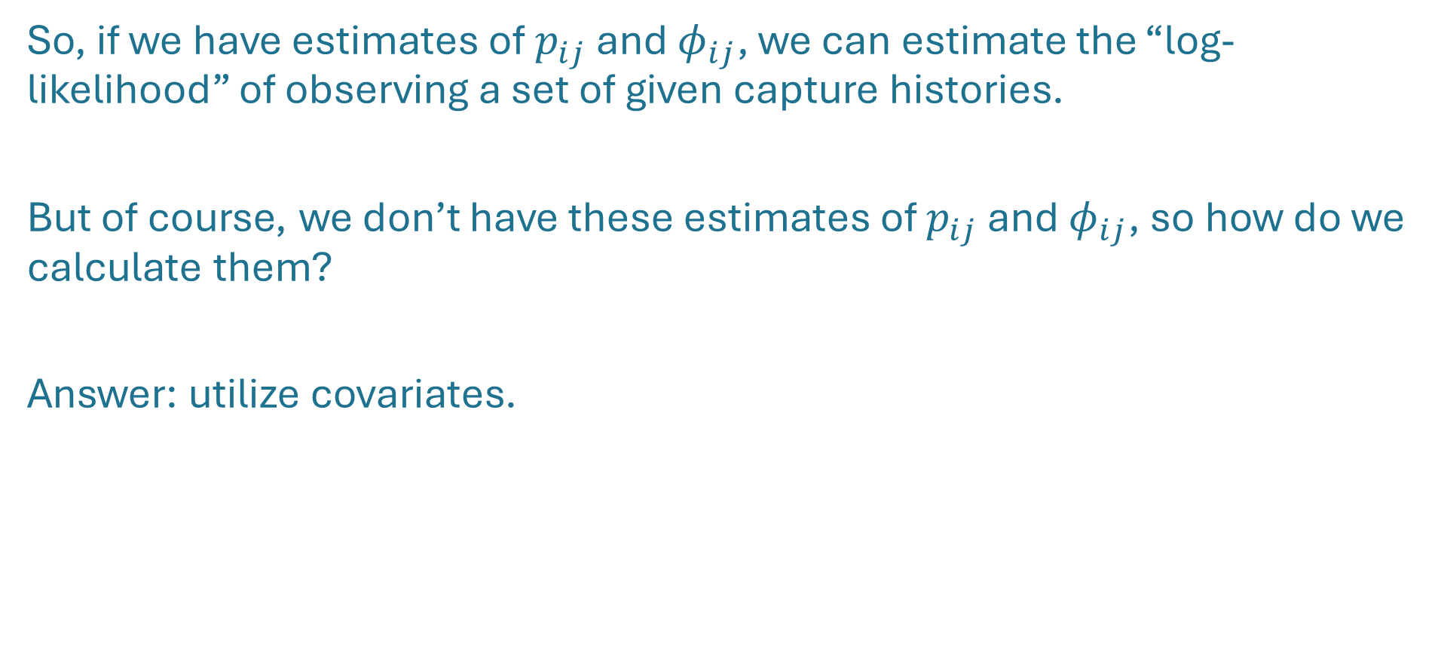
Estimating $p_{ij}$ and ${\text{φ}}_{ij}$
So, if we have estimates of $p_{ij}$ and ${\text{φ}}_{ij}$, we can estimate the “log-likelihood” of observing a set of given capture histories.
But of course, we don’t have these estimates of $p_{ij}$ and ${\text{φ}}_{ij}$, so how do we calculate them?
Answer: utilize covariates.

Slide 14
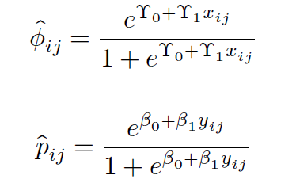
Logistic regression of $p_{ij}$ and ${\text{φ}}_{ij}$
The probability of capture or survival given a specific covariate can best be represented with logistic regression models:

Slide 15
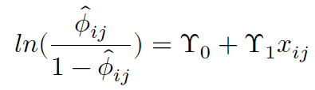
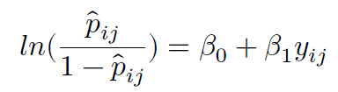
Logistic regression of $p_{ij}$ and ${\text{φ}}_{ij}$
The prior logistic models can be transformed to “logit” (log odds) functions to model the probabilities as linear functions of our covariates:

Slide 16
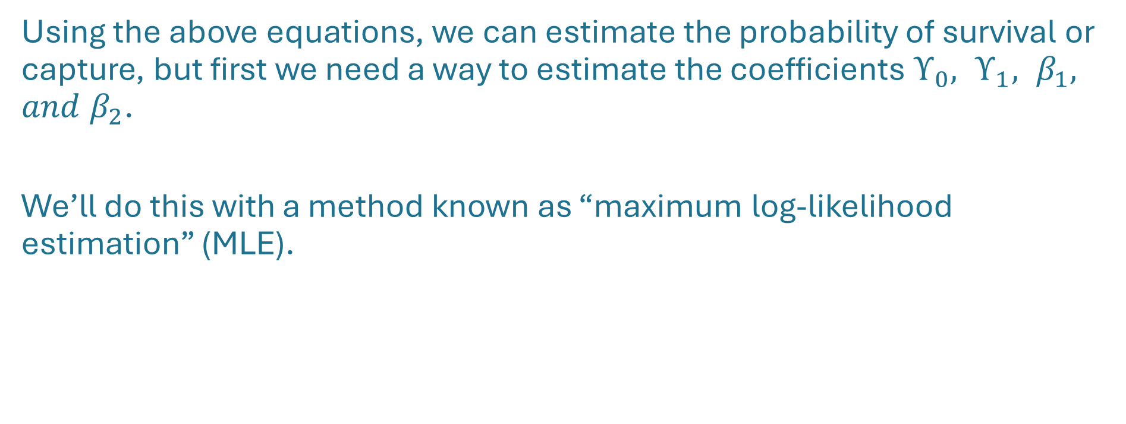
Maximum log-likelihood estimation (MLE)
Using the above equations, we can estimate the probability of survival or capture, but first we need a way to estimate the coefficients $ϒ_{0}, ϒ_{1}, β_{1}, and β_{2}$.
We’ll do this with a method known as “maximum log-likelihood estimation” (MLE).

Slide 17
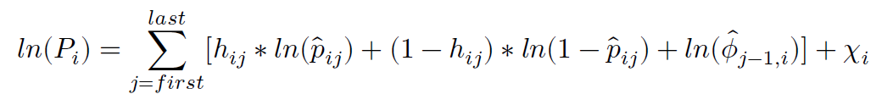
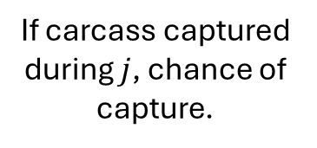

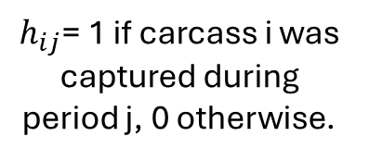
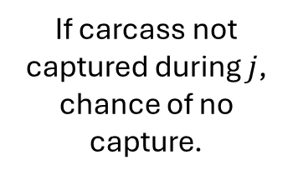
Maximum log-likelihood estimation (MLE)
Recall the above equation, where "$\ln\left(P_{i}\right)" is the$log-likelihood of observing the capture history for a given carcass.
If carcass captured during $j$, chance of capture.
If carcass not captured during $j$, chance of no capture.
Chance carcass survives from j-1 to j.
$$chi$$
$h_{ij}$= 1 if carcass i was captured during period j, 0 otherwise.

Slide 18
Maximum log-likelihood estimation (MLE)
j=2
j=3
j=4
$$ln(01010|release j=2)=\left[ln{(\hat{p}}_{i2}\right)+ln{(\hat{ϕ}}_{i1})]+\left[ln{(1−\hat{p}}_{i3}\right)+ln{(\hat{ϕ}}_{i2})]+\left[ln{(\hat{p}}_{i4}\right)+ln{(\hat{ϕ}}_{i3})]+χ_{i}$$

Slide 19
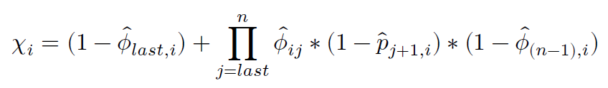
Maximum log-likelihood estimation (MLE)
Chance carcass ‘dies’ immediately after last observation
Product of all probabilities carcass survived but wasn’t seen for each observation point between last capture and n-1

Slide 20

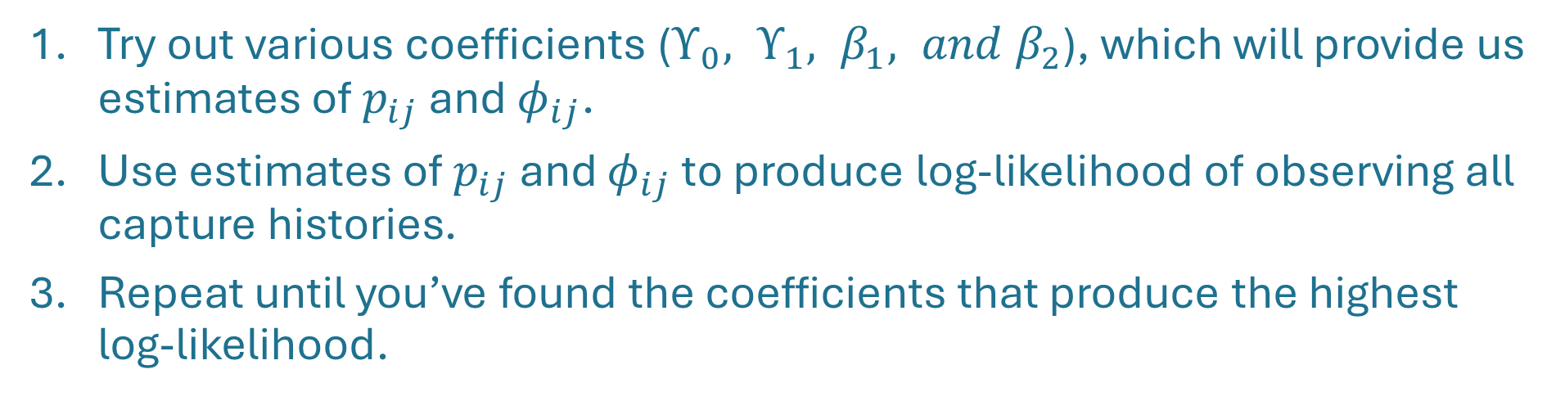
Maximum log-likelihood estimation (MLE)
$${\hat{Φ}}_{ji},{\hat{p}}_{ji}$$
Try out various coefficients ($ϒ_{0}, ϒ_{1}, β_{1}, and β_{2}$), which will provide us estimates of $p_{ij}$ and ${\text{φ}}_{ij}$.
Use estimates of $p_{ij}$ and ${\text{φ}}_{ij}$ to produce log-likelihood of observing all capture histories.
Repeat until you’ve found the coefficients that produce the highest log-likelihood.

Slide 21
Maximum log-likelihood estimation (MLE)
For a simple overview of MLE: https://www.youtube.com/watch?app=desktop&v=XepXtl9YKwc
Of course, our datasets are large, and with multiple covariates, the MLE process is made too complicated to do by hand.
In brief: MLE allows us to get “best guess” answers for problems with no analytical solution.
Fortunately, we can use optimization algorithms to do the work for us.

Slide 22
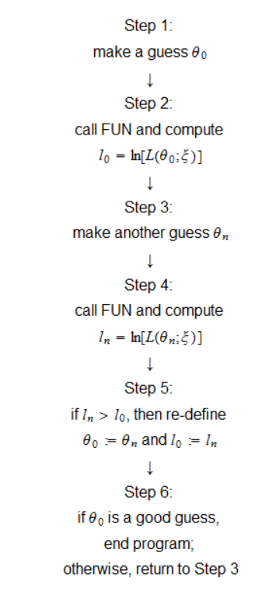
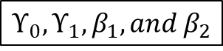
Maximum log-likelihood estimation (MLE)
Optimization Algorithms: https://www.statlect.com/fundamentals-of-statistics/maximum-likelihood-algorithm
$$ϒ_{0}, ϒ_{1}, β_{1}, and β_{2}$$
Covariates
Capture histories
Optimization algorithm

Slide 23
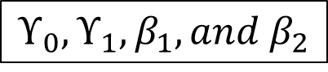
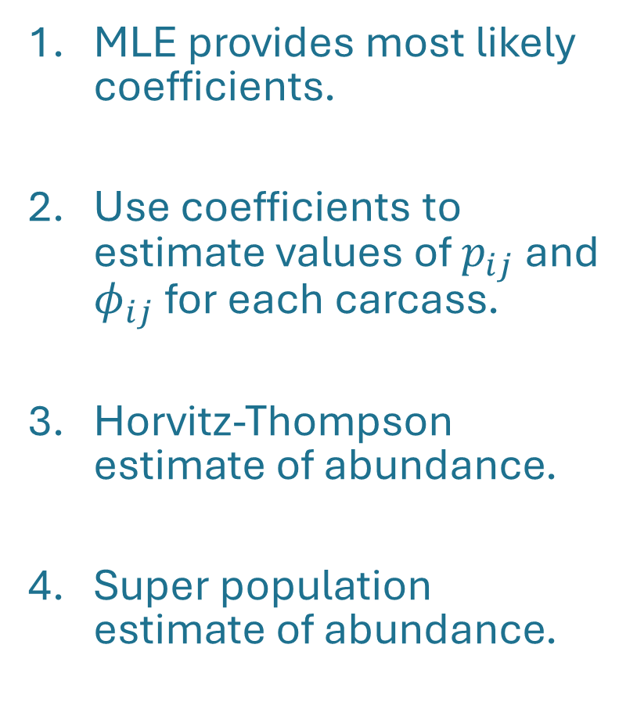

Wrapping up
MLE provides most likely coefficients.
Use coefficients to estimate values of $p_{ij}$ and ${\text{φ}}_{ij}$ for each carcass.
Horvitz-Thompson estimate of abundance.
Super population estimate of abundance.
$$ϒ_{0}, ϒ_{1}, β_{1}, and β_{2}$$
$${\hat{Φ}}_{ji},{\hat{p}}_{ji}$$

Slide 24
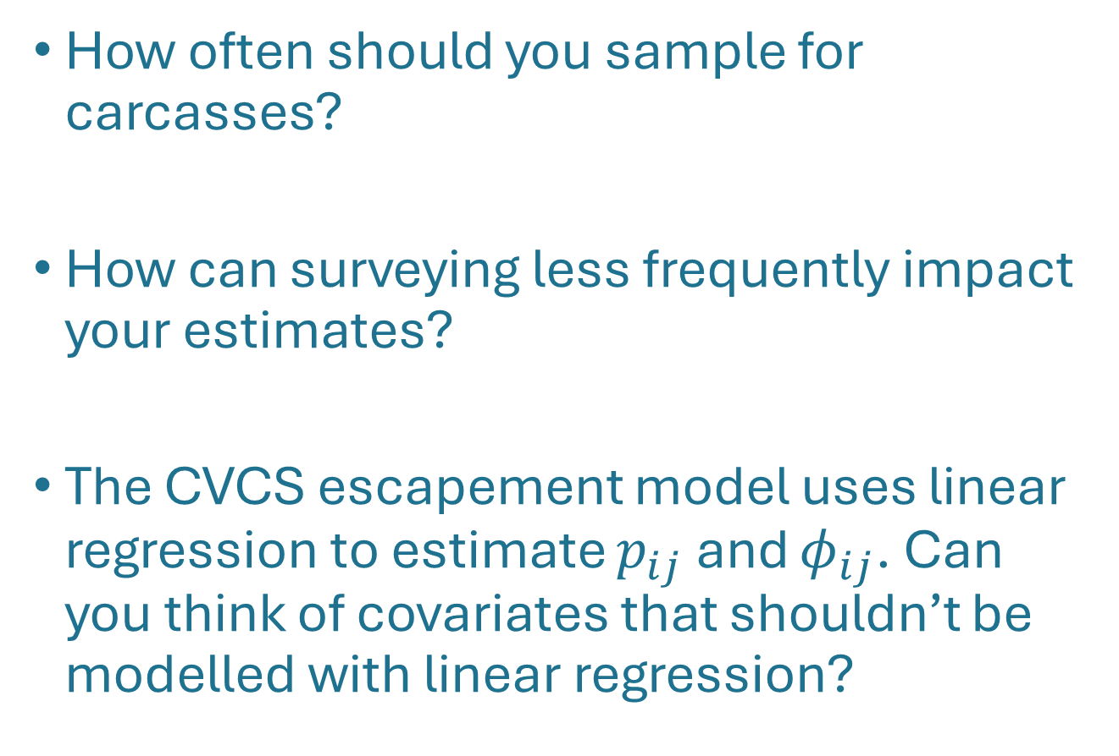
Consider the following:
How often should you sample for carcasses?
How can surveying less frequently impact your estimates?
The CVCS escapement model uses linear regression to estimate $p_{ij}$ and ${\text{φ}}_{ij}$. Can you think of covariates that shouldn’t be modelled with linear regression?

